Slide 1


Amazon Sales Data Analysis Report
Presentated by Gourav Gaikwad

Slide 2

Introduction
Welcome to our Amazon Sales Data Analysis Project presentation. In this report, we will analyze key sales metrics from Amazon, aiming to uncover valuable insights to drive strategic decision-making. Join us as we explore the data to optimize sales strategies and enhance customer experiences in the competitive e-commerce landscape.

Slide 3
Objective
Benefits
Sales management has gained importance to meet increasing competition and the need for improved methods of distribution to reduce cost and to increase profits. Sales management today is the most important function in a commercial and business
enterprise.
•Help out to make better business decisions.
•Help analyze customer trends and
satisfaction, which can lead to new and
better products and services.
•Gives better insight of customers base.
•Helps in easy flow for managing resources.

Slide 4
Problem Statement
Develop a Report by Extracting-Transforming-Loading of data which contains Sales trend with respect to
Yearly-wise, Month-wise, Yearly_month-wise
and find Some relationships through data to understand and Analyze the Facts

Slide 5






Project Workflow
Data Exploration and Cleaning
PowerBI Dashboard Creation
DAX Functions & Data Analysis
Visualization & Insights
Data Stoerytelling &Recommendations

Slide 6

My
Dashboards

Slide 7
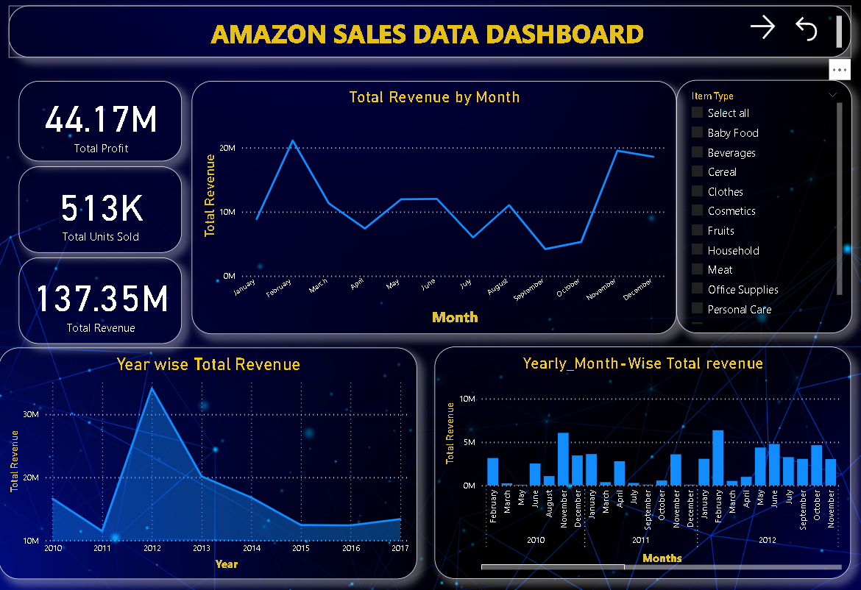

Sales Analysis

Slide 8
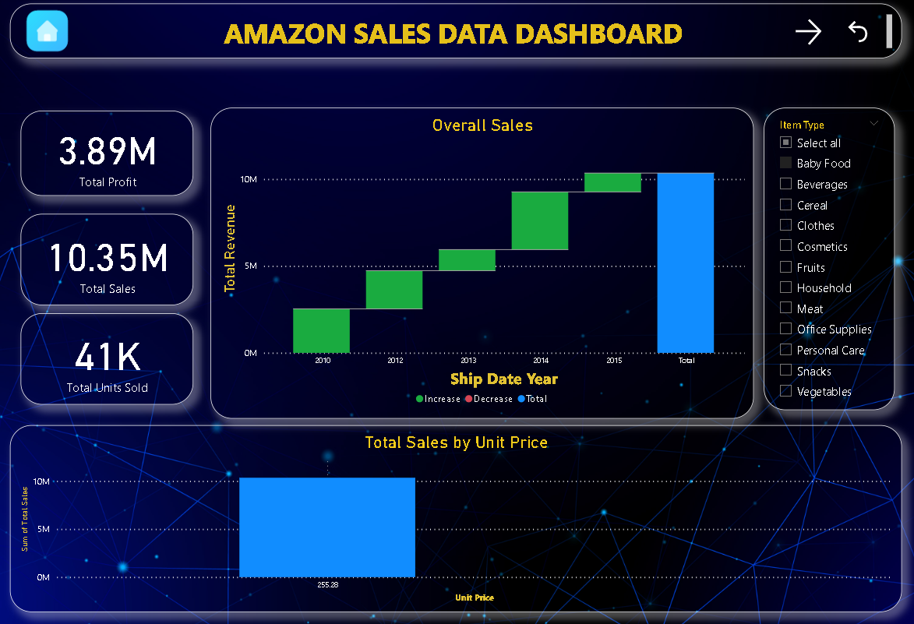
Product Analysis

Slide 9
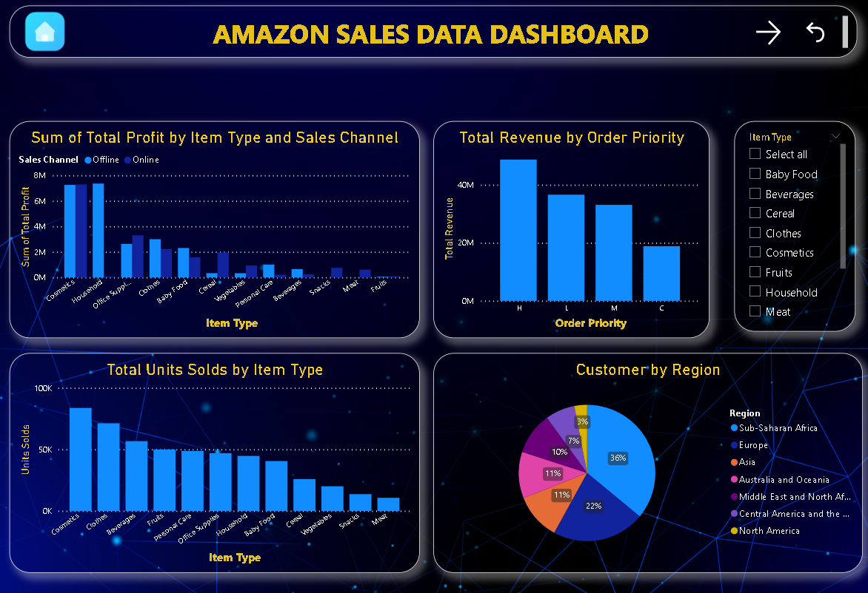
Customer Analysis

Slide 10
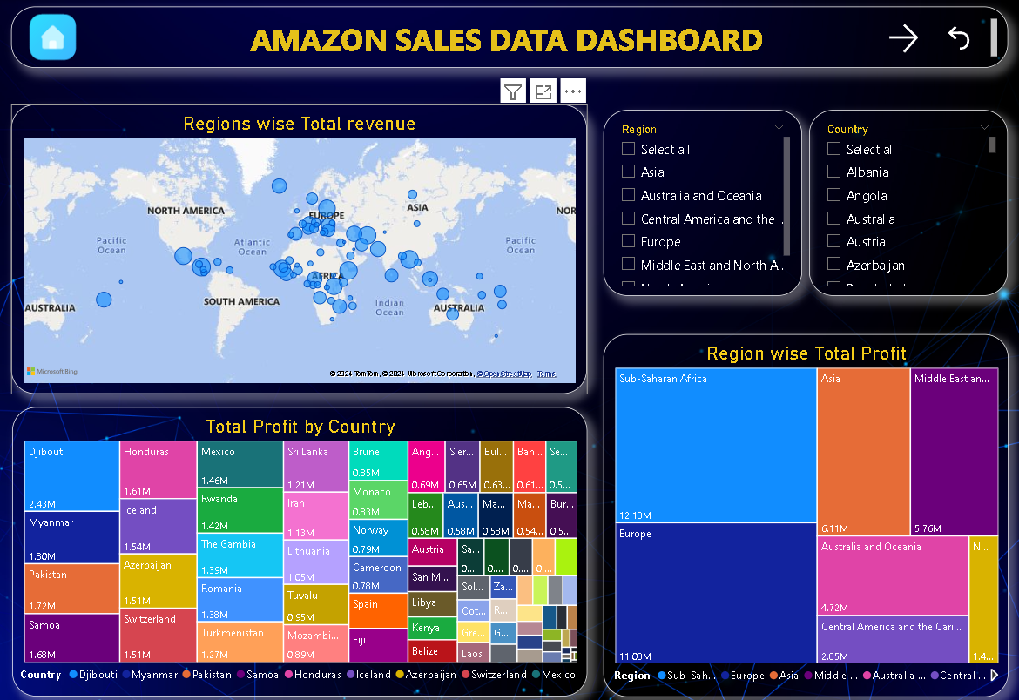
Geographic Analysis

Slide 11





Revenue Trends by months
Insights
Generated
Our revenue trend analysis reveals a fluctuating pattern throughout the year. Starting slow in January, there was a notable increase in February, followed by a steady decline from March onwards. However, there's a positive trend from October to December, indicating potential seasonal opportunities. Understanding these fluctuations is crucial for our strategic planning.
Revenue Trends over years
Our revenue trend analysis reveals notable fluctuations over the years. Starting at 17-18 million in 2010, there was a decrease to 8-10 million in 2011, followed by a steady increase to 40-50 million by 2012. However, revenues then declined until 2015 before slowly increasing again until 2017. Understanding these patterns is crucial for strategic decision-making.

Slide 12


Revenue Trends yealry month wise
Insights
Generated
Our analysis of yearly month-wise revenue trends from 2010 to 2017 reveals a consistent pattern, with average revenues ranging between 3-5 million dollars each month. This stability underscores our ability to maintain a reliable revenue base, facilitating informed strategic decisions and highlighting opportunities for growth.
Product revenue analysis
Our analysis of product revenue over the years shows a consistent upward trend, reflecting increasing demand and market acceptance. Visualizing this data underscores our success and guides strategic decisions for sustained growth.

Slide 13


Total revenue by unit price
Insights
Generated
The total revenue by unit price graph clearly illustrates revenue trends across product types. Cosmetics dominate with revenues ranging from 35 to 40 million dollars, followed closely by household and office supplies at 30 to 34 million dollars. In contrast, fruit products exhibit the lowest revenue, ranging from 0.4 to 0.7 million dollars. This snapshot emphasizes the importance of cosmetics as the primary revenue driver while signaling potential areas for growth in other product categories.
Total Profit by item type and sales channel
The Total Profit by item type and sales channel graph shows clear profit trends. Cosmetics achieve nearly equal profitability both offline and online, ranging from 6 to 8 million dollars. Household items excel in offline channels, yielding profits of 7 to 8 million dollars. Conversely, fruit products demonstrate lower profitability. This snapshot emphasizes the balanced success of cosmetics across channels and the importance of offline sales for certain categories like household items.

Slide 14

Total revenue by order Priority
Insights
Generated
Analyzing the Total Revenue by order priority unveils distinctive revenue patterns. Customers with order priority 'H' exhibit the highest revenue generation, while those with priority 'C' demonstrate the lowest. This insight underscores the significance of order priority in revenue generation, providing valuable direction for resource allocation and customer segmentation strategies.
Customers by Regions
Analyzing customers by regions reveals notable disparities in customer distribution. Sub-Saharan Africa emerges as the region with the highest customer base, constituting 36% of total customers, while North America accounts for a mere 3%. This data highlights the importance of targeting strategies tailored to regional preferences and market dynamics, with a focus on leveraging opportunities in regions with significant customer presence like Sub-Saharan Africa.

Slide 15

Insights
Generated
Geographic Analysis
In our geographic analysis, we delve into region-wise total revenue and country-wise total profit to gain insights into our revenue and profitability distribution. The visual representation of region-wise total revenue allows us to identify the regions contributing the most revenue, facilitating strategic decisions on resource allocation and market focus. Simultaneously, the country-wise total profit visualization enables us to pinpoint the countries yielding the highest profits, guiding targeted business strategies and investment decisions. This comprehensive analysis aids in optimizing revenue generation and profitability across different geographic regions and countries, ensuring a robust and sustainable business growth trajectory.

Slide 16


Conclusion
2012 had the highest Revenue at 31.89.M, followed by 2013 at 20.33M
and 2010 at 19.18M.
If we observe the monthly insights from 2010 to 2017, the sales are at their peak in February,April,May,July&October and are low in March, August & December. Amazon can come up with some good discounts and offers to generate high revenue.
If we observe the monthly insights from 2010 to 2017, the sales are at their peak in February,April,May,July&October and are low in March, August & December. Amazon can come up with some good discounts and offers to generate high revenue.
The Cosmetics& Clothes are the highest selling products followed by Office supplies in domestic and international markets.
Cosmetics,Household and Office supplies are the item types to generate More Revenue.

Slide 17


Thanks

